Slide 1
Maharaja Agrasen Institute of Technology ETCS 211 Computer Graphics & Multimedia UNIT 1
BRESENHAM’S LINE DRAWING ALGORITHMS

Slide 2
The Bresenham’s Line Algorithm
The Bresenham’s algorithm is another incremental scan conversion algorithm
The big advantage of this algorithm is that it uses only integer calculations

Slide 3
Bresenham’s Line Algorithm cont..
True line
t_{k}
s_{k}
For a given value of x
one pixel lies at distance t_{k} above the line, and
one pixel lies at distance s_{k} below the line

Slide 4
Bresenham’s Line Algorithm cont..
Decision parameter
p_{k} = (s_{k} - t_{k})
If p_{k} < 0, then closest pixel is below true line (s_{k} smaller)
If p_{k} ≥ 0, then closest pixel is above true line (t_{i}ksmaller)
We must calculate the new values for p_{k} as we move along the line.

Slide 5
Bresenham’s Line Algorithm cont..
Algorithm
Input line end points
Load (x₀,y₀) to plot the first point.
Calculate dx,dy, 2dy and 2dy-2dx and obtain the starting value of the decision parameter as p₀=2dy-dx
At each x_{k} along the line, starting at k=0, perform the following test
if p_{k} <0, the next point plot is (x_{k}+1, y_{k}) and
p_{k+1}=p_{k}+2dy
Other wise, the next point to plot is (x_{k}+1, y_{k}+1) and
p_{k+1}=p_{k}+2dy-2dx
5. Repeat step-4 dx times.

Slide 6
Example
(Bresenham’s Line Algorithm )
Draw a line from (20,10) to (30,18)
dx = 10 dy = 8 initial decision d₀ = 2dy – dx = 6
Also 2dy = 16, 2(dy – dx) = -4
k p_{k} (x_{k+1},y_{k+1})
19
18
17
16
15
14
13
12
11
10
 | 20 | 21 | 22 | 23 | 24 | 25 | 26 | 27 | 28 | 29 | 30 | 31 | 32
0 6 (21,11)
1 2 (22,12)
2 -2 (23,12)
3 14 (24,13)
4 10 (25,14)
5 6 (26,15)
6 2 (27,16)
7 -2 (28,16)
8 14 (29,17)
9 10 (30,18)

Slide 7
Bresenham’s Line Algorithm cont..
Special cases
Special cases can be handled separately
Horizontal lines (Δy = 0)
Vertical lines (Δx = 0)
Diagonal lines (|Δx| = |Δy|)
directly into the frame-buffer without processing them through the line-plotting algorithms.

Slide 8
Bresenham’s Algorithm Example Where m<=1
Suppose we want to draw a line starting at pixel (2,3) and ending at pixel (12,8).
dx = 12 – 2 = 10
dy = 8 – 3 = 5
p0 = 2dy – dx = 0
2dy = 10
2dy – 2dx = -10
Algorithm
Input the two line endpoints and store left endpoint as (x0,y0)
Pre-calculate the values dx, dy, 2dy and 2dy -dx
Color pixel (x0,y0)
Let p0 = 2dy –dx
At each xk along the line, starting with k=0:
If pk<0, then the next point to plot is (xk + 1,yk), and pk+1 = pk + 2dy (Down pixel will be selected) Otherwise, the next point to plot is (xk + 1, yk + 1), and pk+1 = pk + 2dy – 2dx (Upper pixel will be selected)
Repeat Step-4 dx times
t | p | P(x) | P(y)
0 | 0 | 2 | 3
1 | -10 | 3 | 4
2 | 0 | 4 | 4
3 | -10 | 5 | 5
4 | 0 | 6 | 5
5 | -10 | 7 | 6
6 | 0 | 8 | 6
7 | -10 | 9 | 7
8 | 0 | 10 | 7
9 | -10 | 11 | 8
10 | 0 | 12 | 8

Slide 9


Anti-aliasing
Anti-aliasing is a method of fooling the eye that a jagged edge is really smooth.
Due to low resolution aliasing effect will occur, which can be removed by increasing the screen resolution.
Jagged edges due to aliasing
Circle after applying antialiasing

Slide 10
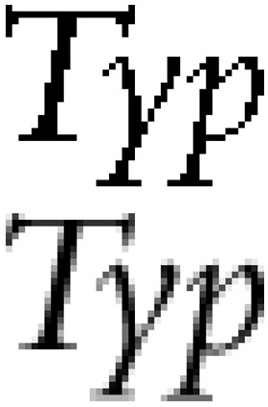
Some more Examples

Slide 11
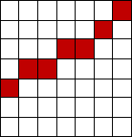
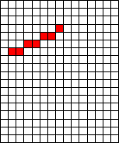
Reducing Aliasing
By increasing Resolution
The aliasing effect can be minimized by increasing resolution of the raster display.

Slide 12
Disadvantage of improving resolution
•
•
More memory requirement (Size of frame buffer will become Large) More scan conversion time

Slide 13
Anti-aliasing Methods
Super-sampling method or post filtering
Area sampling or Pre filtering

Slide 14
Super-sampling Method (Cont….)
In this method every individual pixel is subdivided in to sub-pixel.
In this method we count the number of pixel which are overlapped by the object.
The intensity value of a pixel is the average of the intensity values of all the sampled sub-pixels with in that pixel.
In this method every pixel on the screen have different intensity.

Slide 15
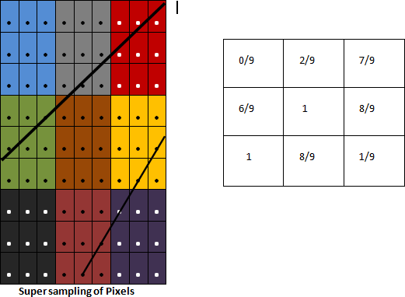
Super-sampling for a line object having Non-Zero width.

Slide 16
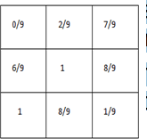
Super-sampling Method (Cont….)
•
Pixel at upper right corner is assigned 7/9 because seven of its nine-sub pixels are inside the object area.
•
Suppose the color of object is RED(1,0,0), and the background color is light yellow (.5,.5,.5).
At what intensity the pixel will glow?
(1 X 7/9 +.5 X 2/9, 0X7/9+ 0.5 X 2/9, 0X7/9+.5X2/9) R G B
Blending of background color and object color will occur only in area of pixel where object overlaps.
Question-
What will be the intensity of center pixel? Answer- (1 X 1+.5X0, 0X1+.5X0, 0X1+.5X0)
What will be the intensity of lower right side pixel? Answer- (1X1/9 + .5X8/9, 0X1/9+.5X8/9, 0X1/9+.5X8/9)

Slide 17
Intensity Variation on pixels after Super sampling method

Slide 18
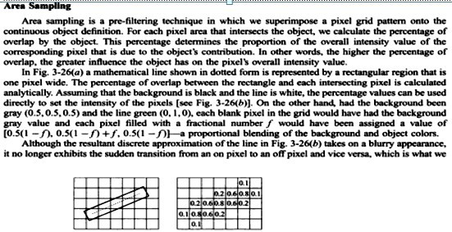
Write Formula for Blending of Colors for following Conditions
Object Background is (.5,.5,.5)
Object Color is (1,1,0) Ans:
Write Formula for Blending of Colors for following Conditions
Object Background is (.5,.5,.5)
Object Color is (1,1,1)

Slide 19
Area Sampling Method
•
This figure shows how line with a non-Zero width have different intensity value at each pixel on the screen
•
In this Area sampling method intensity value is determined according to area covered by the object.
90%
15%
65%
50%

Slide 20
Q & A
1. The Cartesian slope-intercept equation for a straight line is a) y = m.x + b b) y = b.x + m c) y = x.x + m d) y = b + m.m
2. For lines with slope magnitude |m|<1, ?x can be_________ a) A set corresponding vertical deflection b) A set proportional to a small horizontal deflection voltage c) Only a d) All of the mentioned
3. On raster system, lines are plotted with a) Lines b) Dots c) Pixels d) None of the mentioned

Slide 21
4. Expansion of line DDA algorithm is a) Digital difference analyzer b) Direct differential analyzer c) Digital differential analyzer d) Data differential analyzer
5. Which algorithm is a faster method for calculating pixel positions? a) Bresenham’s line algorithm b) Parallel line algorithm c) Mid-point algorithm d) DDA line algorithm
6. The disadvantage of lineDDA is a) Time consuming b) Faster c) Neither a nor b d) None of the mentioned

Slide 22
7. An accurate and efficient raster line-generating algorithm is a) DDA algorithm b) Mid-point algorithm c) Parallel line algorithm d) Bresenham’s line algorithm
8. In Bresenham’s line algorithm, if the distances d1 < d2 then decision parameter Pk is______ a) Positive b) Equal c) Negative d) Option a or c
9. Which is the best line algorithm to balance the processing load among the processers? a) Parallel line algorithm b) DDA line algorithm c) Bresenham’s line algorithm d) Position Bresenham’s line algorithm

Slide 23
10. The algorithm which uses multiple processors to calculate pixel positions is a) Midpoint algorithm b) Parallel line algorithm c) Bresenham’s line algorithm d) All of the mentioned
11. Coordinate references in the polyline function are stated as a) Relative coordinate values b) Absolute coordinate values c) Current position d) Real coordinate values

